Slide 1
Douglas Crimp: On The Museums Ruins

Slide 2
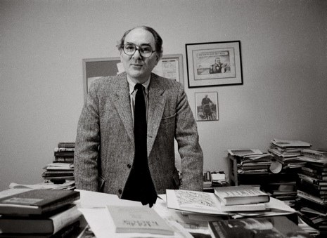
Hilton Kramer
Hilton Kramer attacked the inclusion of salon painting. Characterizing that art as silly, sentimental and impotent, Kramer went on to assert that, had the reinstallation been done a generation earlier, such pictures would have remained in the museum’s storeroom, to which they has so justly been consigned.

Slide 3
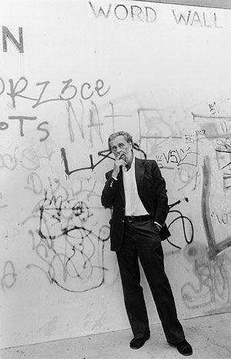
Post Modernism
Flatbed: “the most radical shift in the subject matter of art, the shift from nature to culture.”
Leo Steinberg “Other Criteria, 1986”

Slide 4
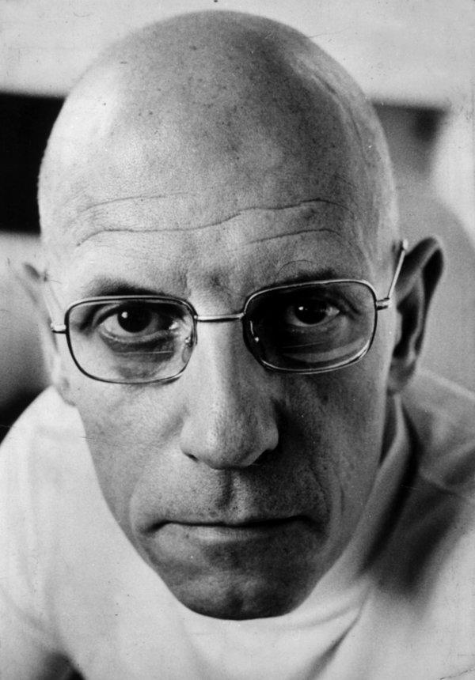
“Not only does the very term postmodern imply the foreclosure of what Foucault would call the episteme, or archive, of modernism, but even more specifically, by insisting upon the radically different kinds of picture surfaces Upon which different kinds of data can be accumulated and organized.” Crimp pg 241.”

Slide 5
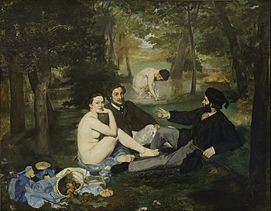
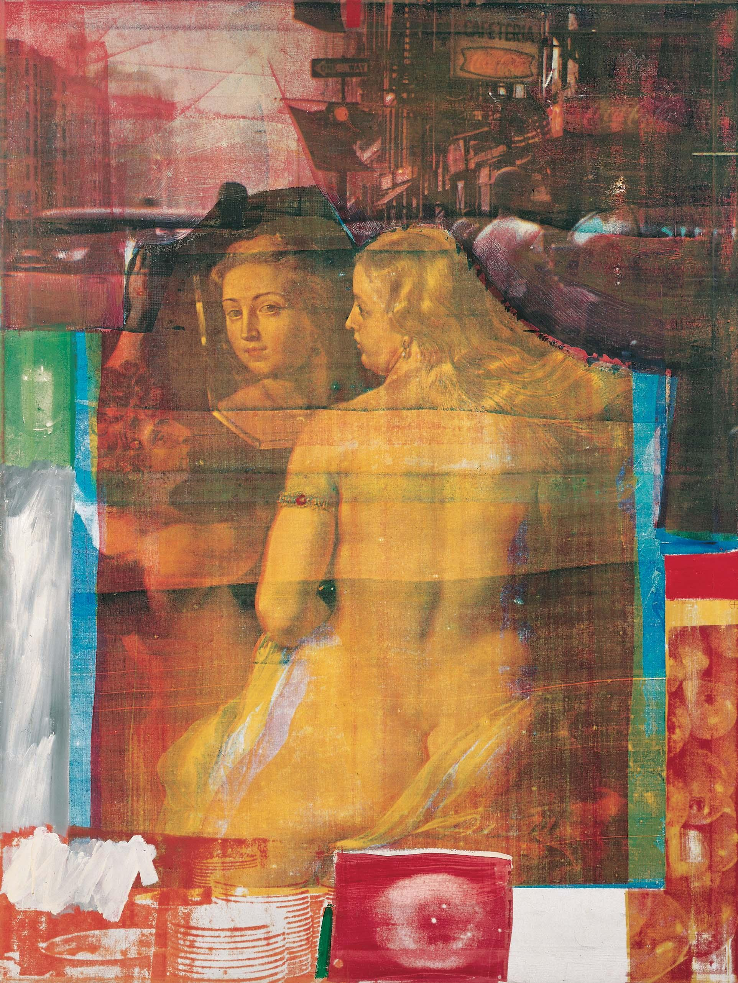
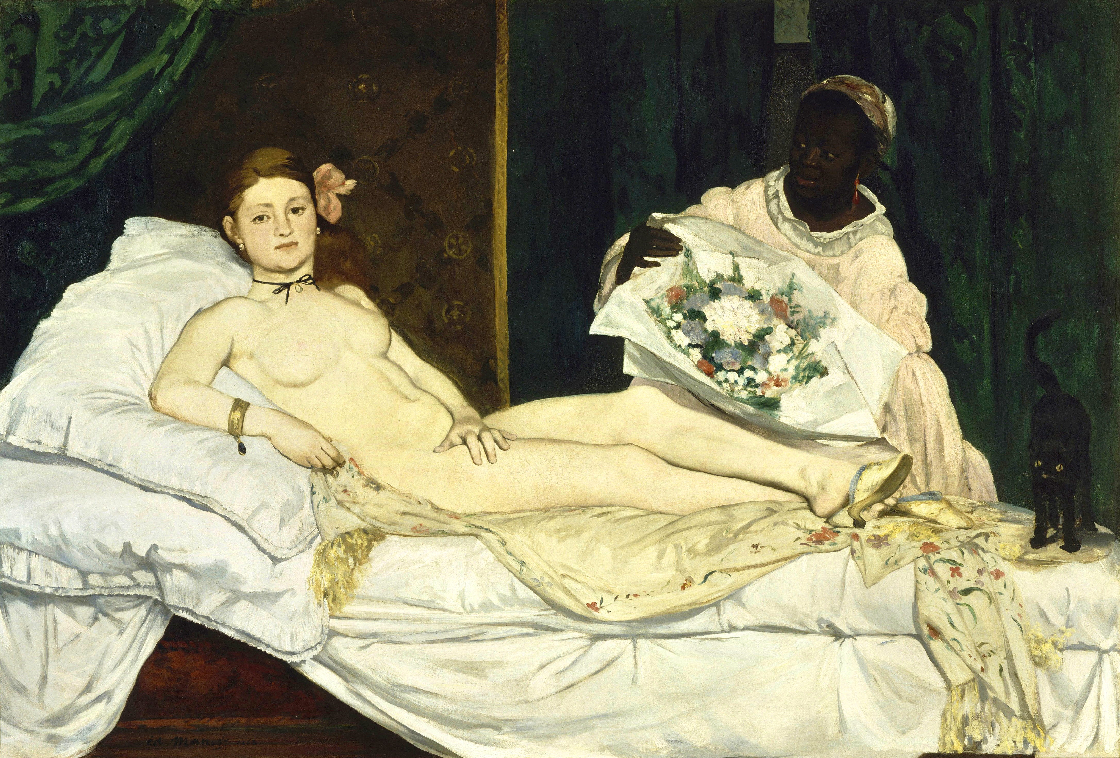
Edouard Manet - Le Déjeuner sur l’herbe, 1863.
Robert Rauschenberg, Persimmon, 1964.
Edouard Manet - Olympia, 1863.

Slide 6


“Flaubert is to the library what Manet is to the Museum.” –pg243

Slide 7
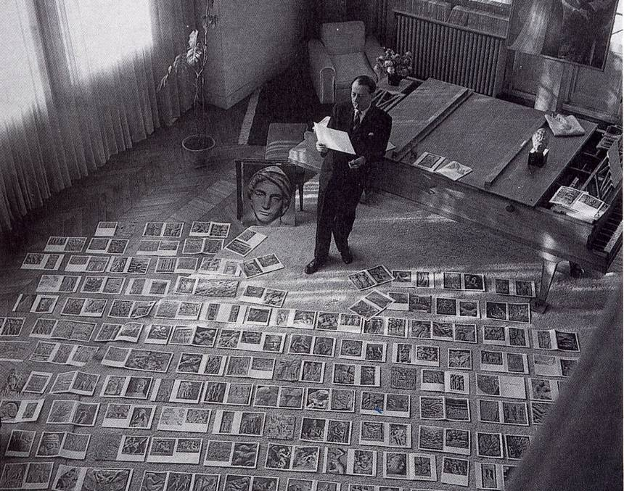
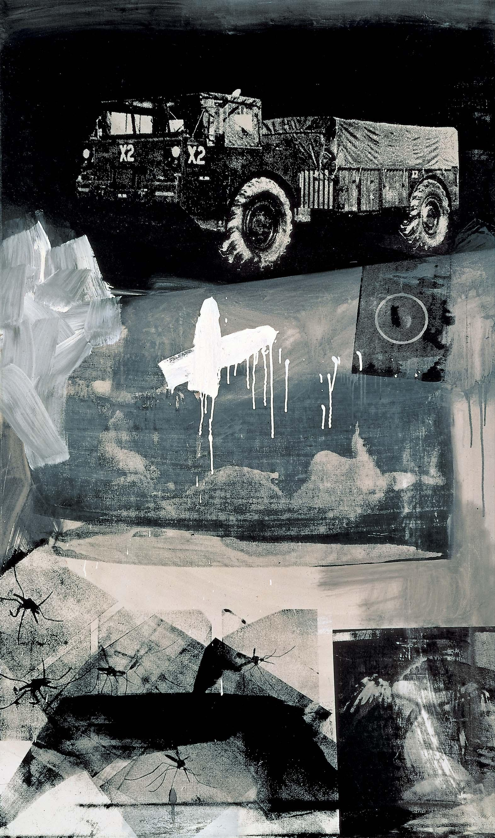
Andres Malraux’s “Building a Museum without walls.”
Crocus
“Malraux was enraptured by the endless possibilities of his
museum by the proliferation of discourse.” – pg 246

Slide 8
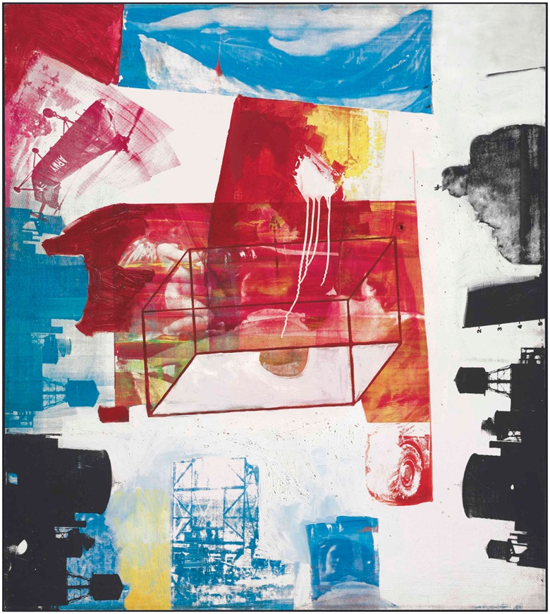
Transom, 1975.

Slide 9
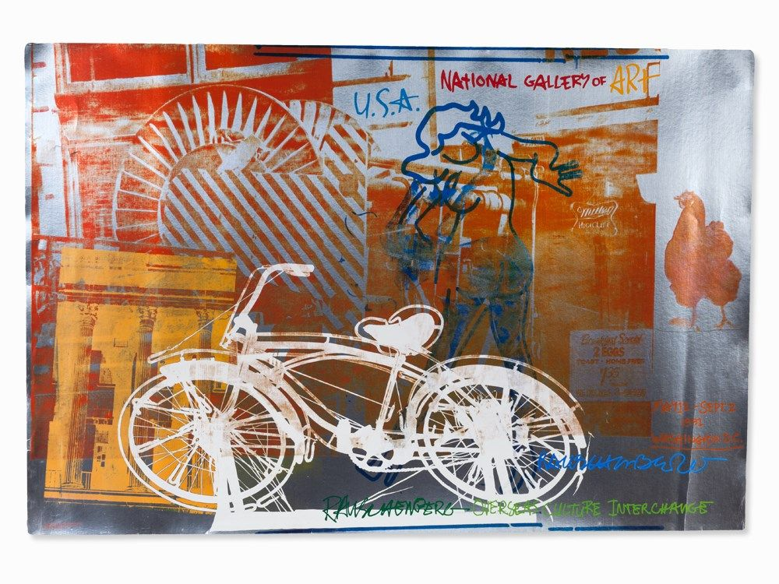
Bicycle 1991.

Slide 10
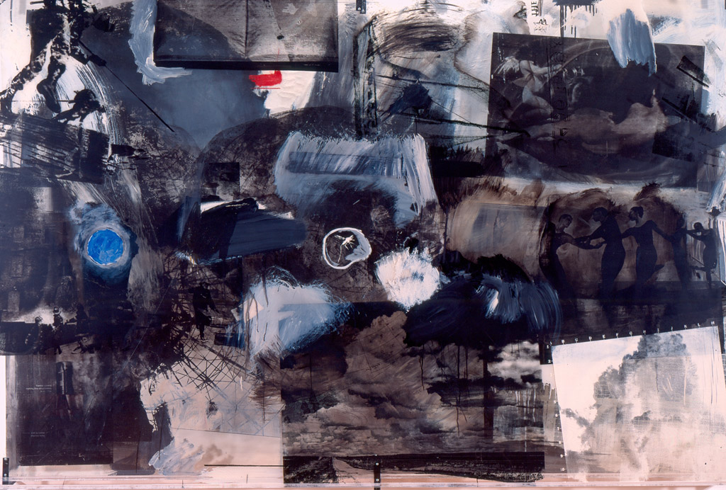
OverCast 3.

Slide 11
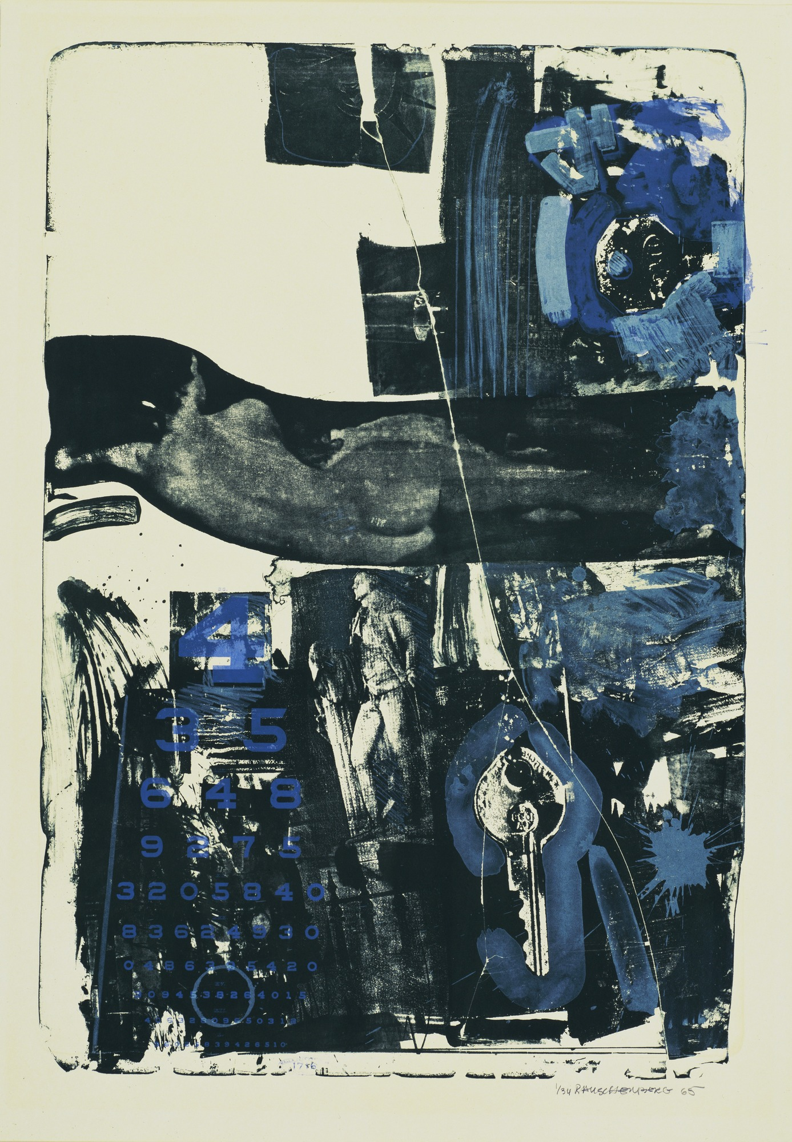
-Treasury of the conscience of man. Masterworks collected, protected and Celebrated commonly. Timeless in concept the museum amasses to concertize a moment of pride serving to defend the dreams and ideals apolitically of mankind aware and responsive to the changes, needs and complexities of current life while keeping history and love alive.
Break Through. 1964

